Slide 1
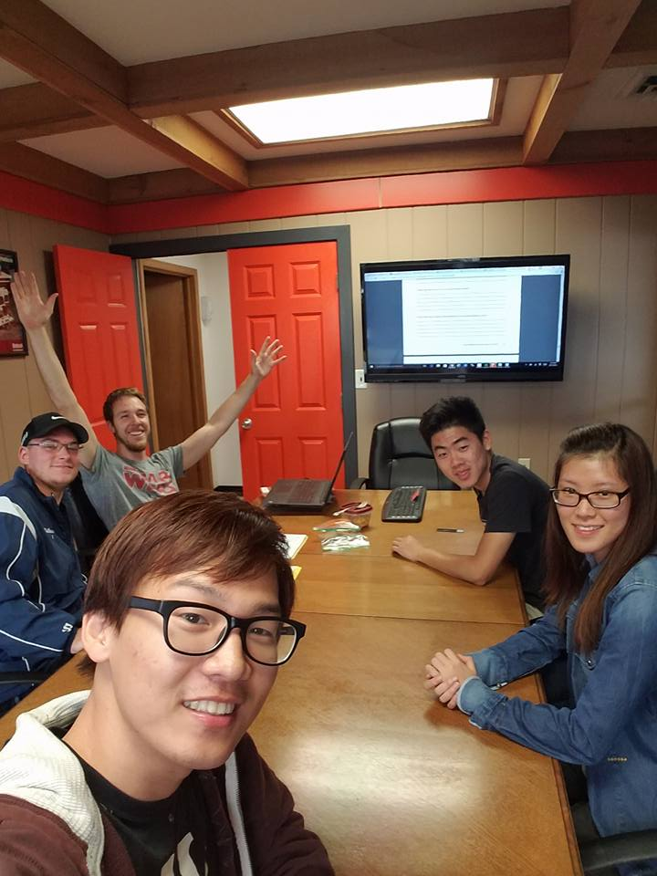
MGS Consulting Group
http://mgs351bobcat.weebly.com/

Slide 2
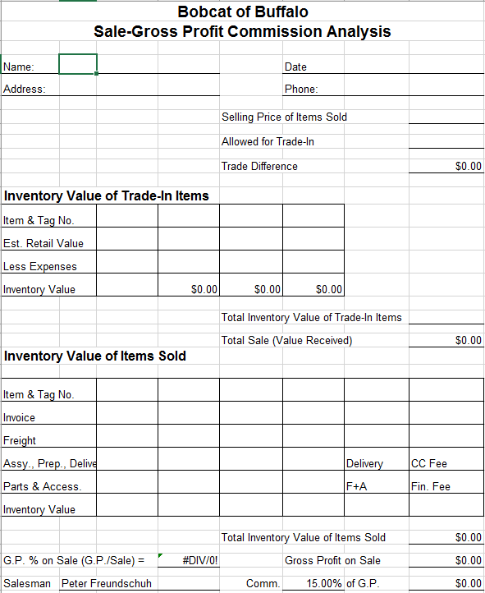
The Original Issue
What we have now ->
Too many intermediaries
Wasted Resources

Slide 3
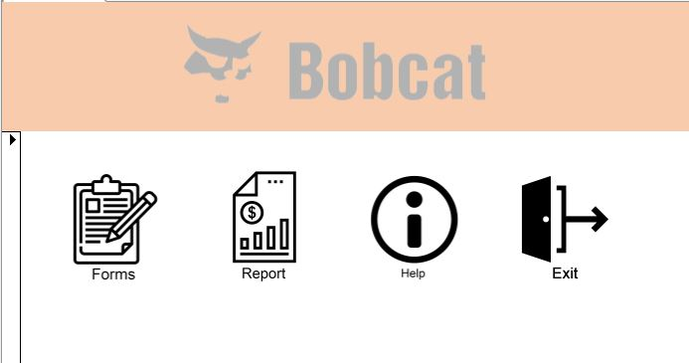
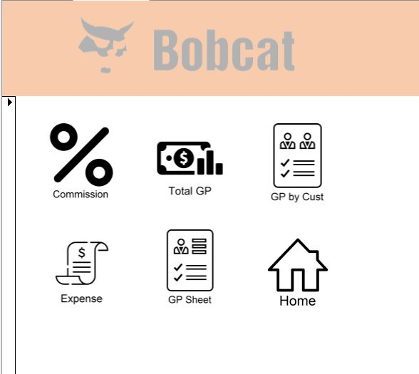
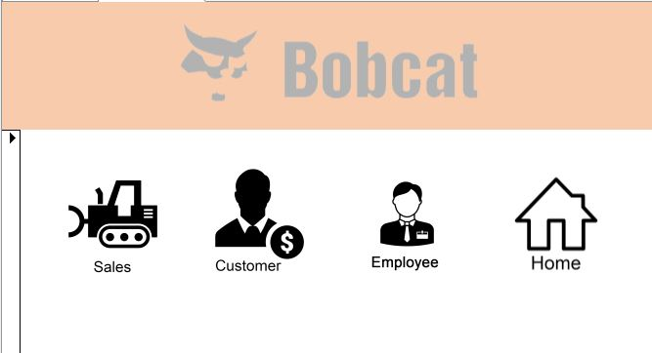
PB-12

Slide 4
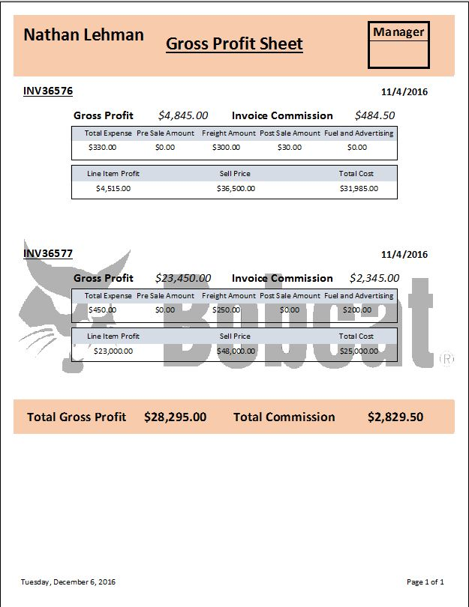

Slide 5
The Added Business Value
Removal Of Redundant Processing
Automated Data Tracking System
Reduction Of Human Error
Future Improvements

